Slide 1
EVBB annual conference in Brussels 21th-24th October 2015
• Erasmus + project
• Key Action: Cooperation for innovation and the exchange of good practices
• Field: Strategic Partnerships for vocational education and training,
• Duration: September 2014 - August 2016
Partners:
Coordinator:“Petru Maior”
University of Tirgu-Mures,
Romania
“Transilvania” Economic College,
Romania
European Association of Institutes for
Vocational Training, Germany
Institute for Technology and
Quality, Portugal
BEST Institut für berufsbezogene
Weiterbildung und Personaltraining GmbH,
Austria
European Center for Quality, Bulgaria
IDEProjet, France

Slide 2
EVBB annual conference in Brussels 21th-24th October 2015
EQAVET
QUALECO
designed to promote better vocational education and training by providing authorities with common tools for the management of quality
sustainable development and quality standards for vocational training organizations
EQVET-US
EVBB
AIMS
To develop the innovative eQvet-us framework and practice set under the EQAVET framework;
To develop the innovative four levels extensive evaluation model for scalable Eco skills and sustainable training evaluation of trainees participating in VET programs as a tool to assess and validate the return of investment in VET programs.
TARGET GROUPS
• Vocational Education and Training providers in each partner country and at European level;
• Policy-makers in VET;
• Consultancy organisations and/or certification bodies for quality management systems;
• VET quality teachers, professionals, experts, etc.

Slide 3
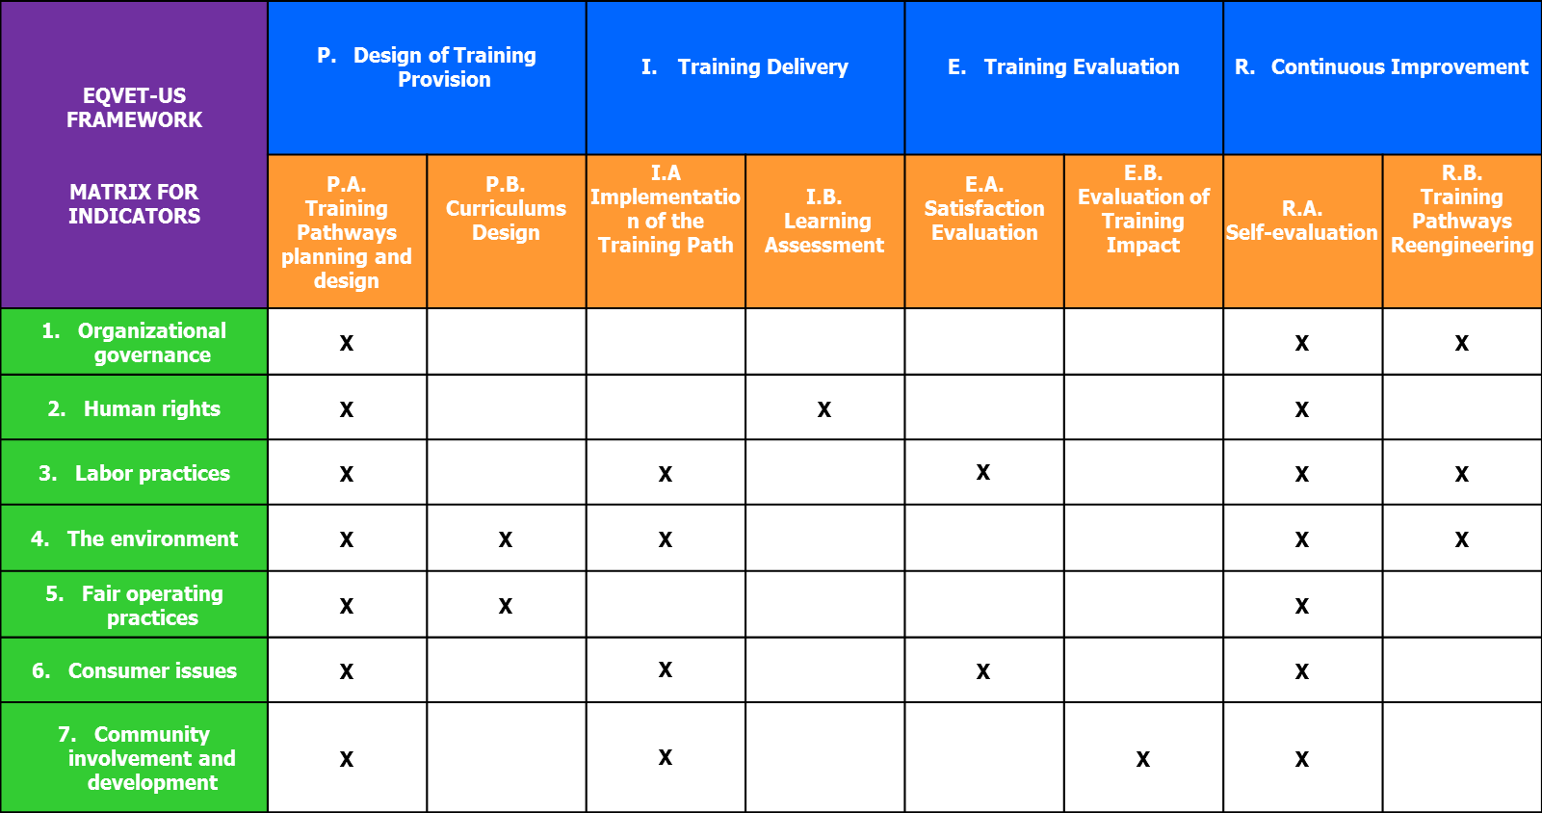
EVBB annual conference in Brussels 21th-24th October 2015
Framework
For each correspondence, EQVET-US Framework establishes at least one indicator and a set of guiding questions, to support the self-evaluation process of VET Providers in regards to the implementation of a sustainable model to continuously improve quality in VET.

Slide 4
EVBB annual conference in Brussels 21th-24th October 2015
Practice Set
Instructions to evaluate measures and activities to improve the eQvet-us-level of the organization in reference to the PDCA-cycle.
Implementation Guide
Framework
Indicator matrix as a structure of the content of eQvet-us.
PRACTICE-SET
Self Diagnostic Tool
Evaluation of derived questions from the framework to formulate the answers which support the preparations of measures.

Slide 5
EVBB annual conference in Brussels 21th-24th October 2015
Self Diagnostic Tool
Evaluation key:
Level “poor” (0 Points): Item is relevant, but not considered until now and no activities,
Level “basic” (1 Points): Item is relevant, measures/activities are planned,
Level “good” (2 Points): Item is relevant, realization at the beginning, in progress or almost finished,
Level “excellent” (3 Points): Item is relevant, an effective measure/process is implemented and monitored.
Quality indicator
Maybe you have answered 40 questions, “excellent” (3 points) would be the highest level, then 40 x 3 points = 120 points (highest score in this case) ≙ 100%. If you reach 76 points in the evaluation (because not all answers are on the excellent level), the eQvet-us quality indicator is 63.3%. Now you can rate this quality indicator by means of the following quality scale:
Quality scale:
poor basic good excellent
25%
50%
85%

Slide 6
EVBB annual conference in Brussels 21th-24th October 2015
Implementation Guide
ANSWER | X | 0 poor | 1 basic | 2 good | 3 excellent
85%
63%
Steps:
1. Self estimation
1.1 Read and understand the framework.
1.2 Choose and answer the questions of the framework.
1.3 Evaluate the Results.
again, what has been improved
and how much?
Self Diagnostic Tool
2. Improvement planning
2.1 Detect the most important aspects and the distance from the excellent level.
2.2 Set priorities and list the aspects/issues which you can improve in a definite time period.
2.3 Formulate quality objectives for this aspects/issues.
2.4 Develop a action plan with content, budget, dates, deadlines and responsibilities.
3. Realization
3.1 Put the action plan into practice, specify the steps of your plan operational.
3.2 Check the effectiveness of your realized measures.
4. New Self estimation

Slide 7
EVBB annual conference in Brussels 21th-24th October 2015
No of the evaluation | date | 1. ORGANIZATIONAL GOVERNANCE | 2. HUMAN RIGHTS | 3. LABOR PRACTICES | 4. ENVIRONMENT | 5. FAIR OPERATING PRACTICES | 6. CONSUMER ISSUES | 7. COMMUNITY INVOLVEMENT AND DEVELOPMENT
1
2
Thank You for Your attention!

